Slide 1


Slide 2
Why Windows Presentation Foundation?

Slide 3
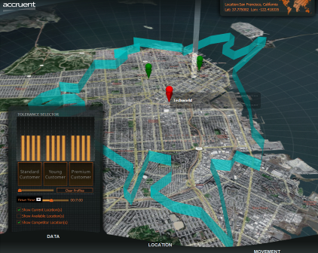
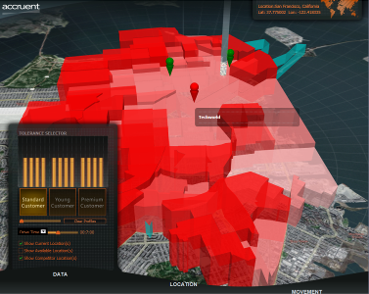
Windows Presentation Foundation
Unified approach to UI, Documents, and Media
Integration as part of development and experience
Integrated, vector-based composition engine
Utilizing the power of the PC throughout the graphics stack
Declarative programming
Bringing designers directly into application development
Ease of deployment
Allowing administrators to deploy and manage applications securely

Slide 4
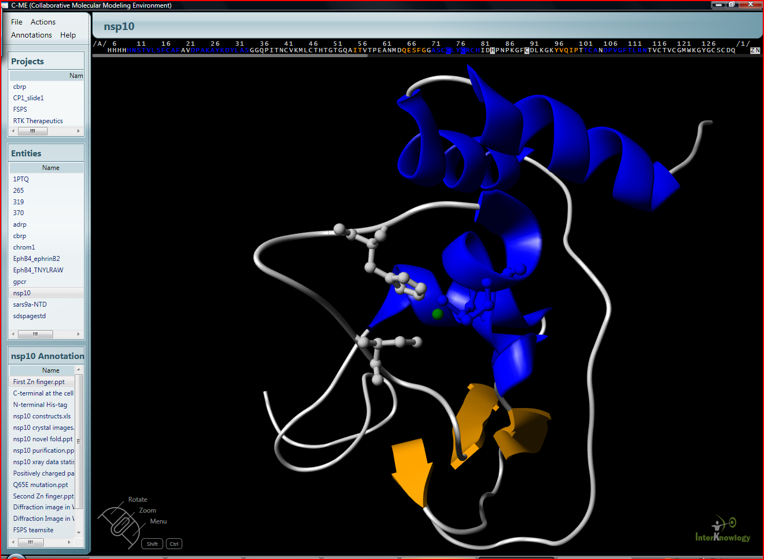
Scripps Healthcare
Allowing cancer researchers to collaborate in the search for a cure

Slide 5
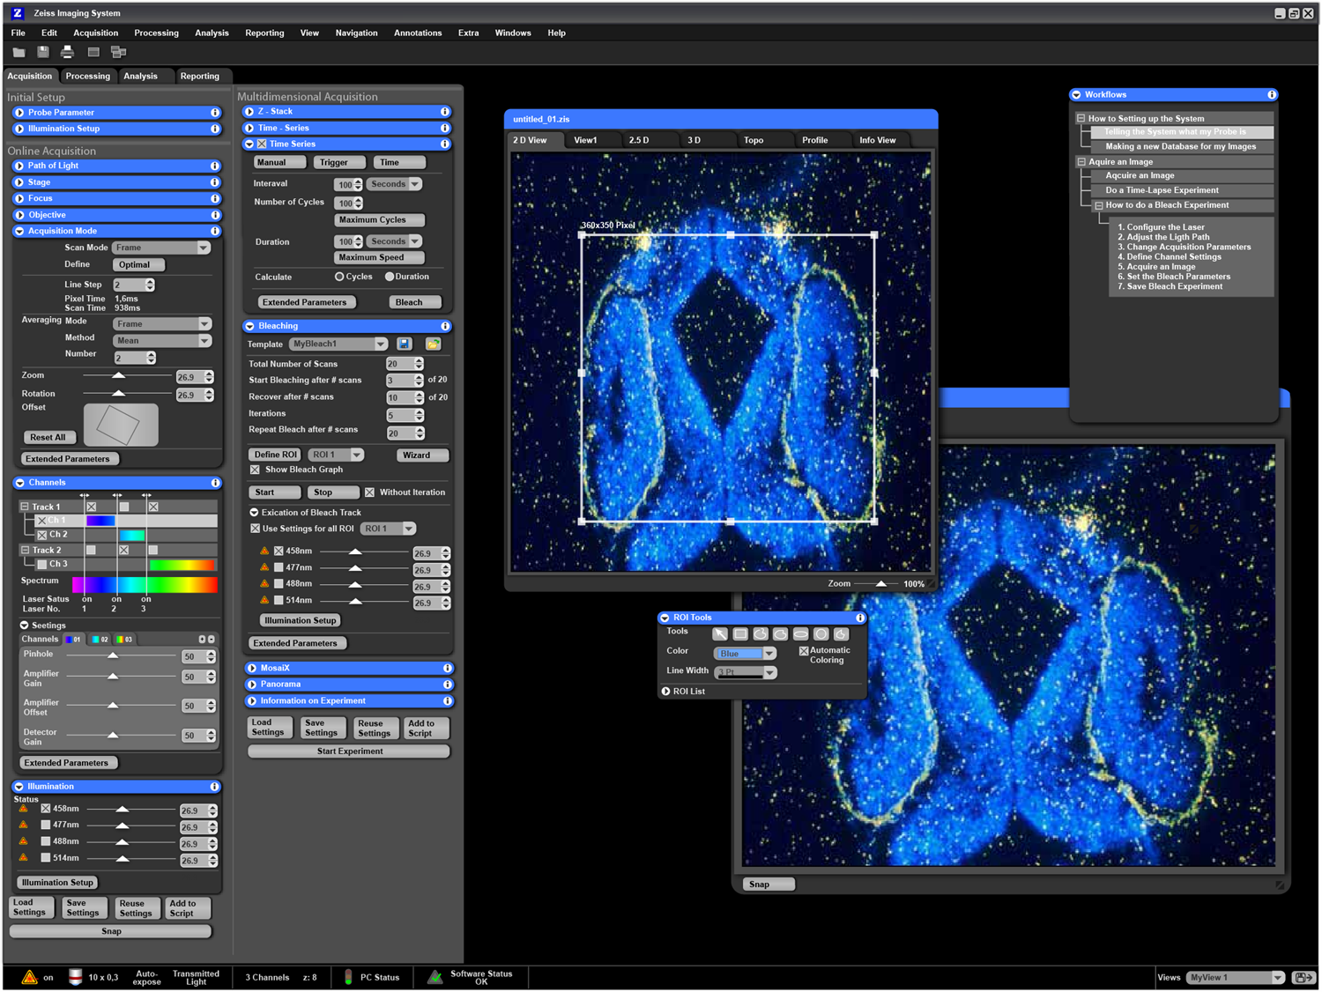
Carl Zeiss
Medical imaging analysis

Slide 6
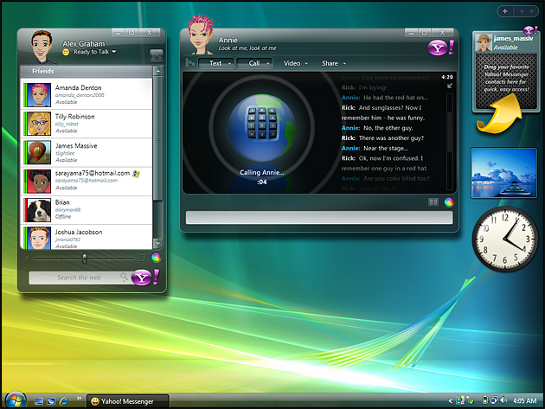
Yahoo
Next-generation instant messaging client

Slide 7
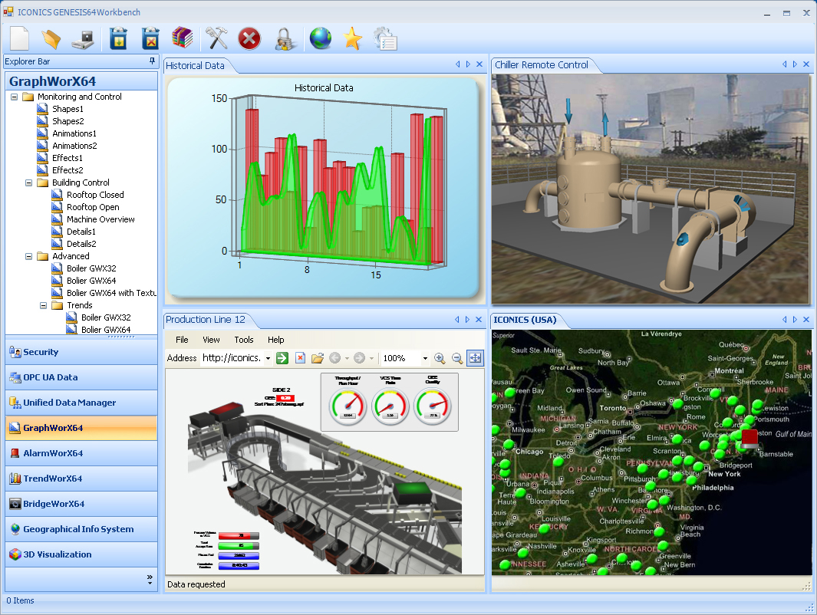
Iconics
Real-time manufacturing visualizations

Slide 8
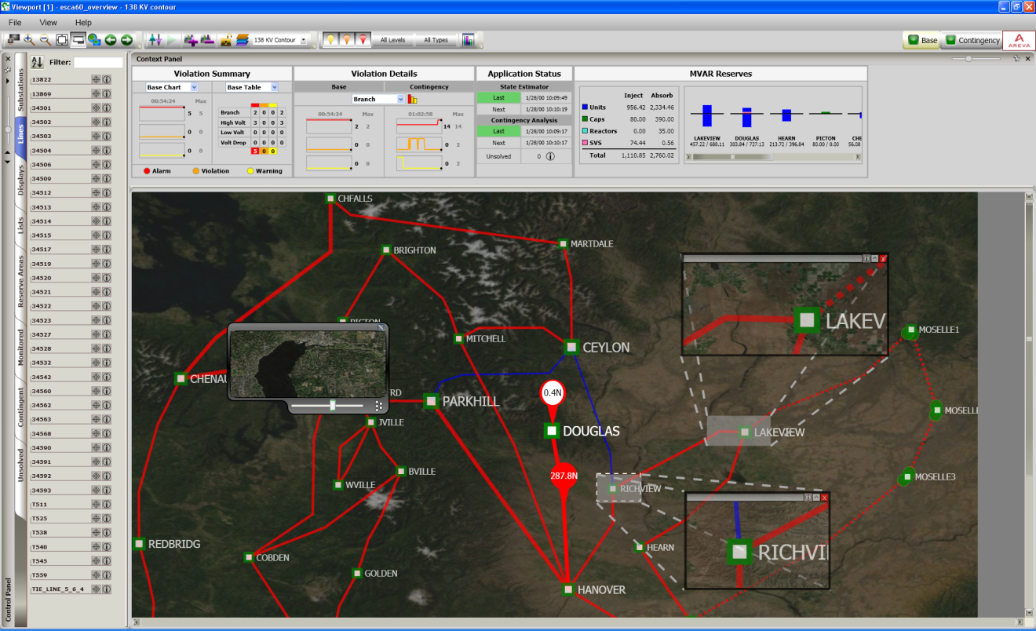
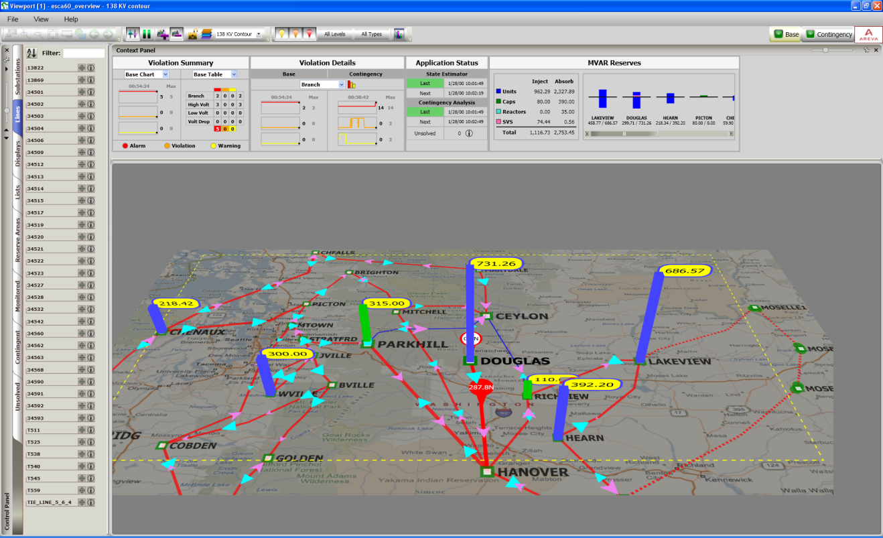
Areva
Monitoring and controlling the electricity power grid

Slide 9
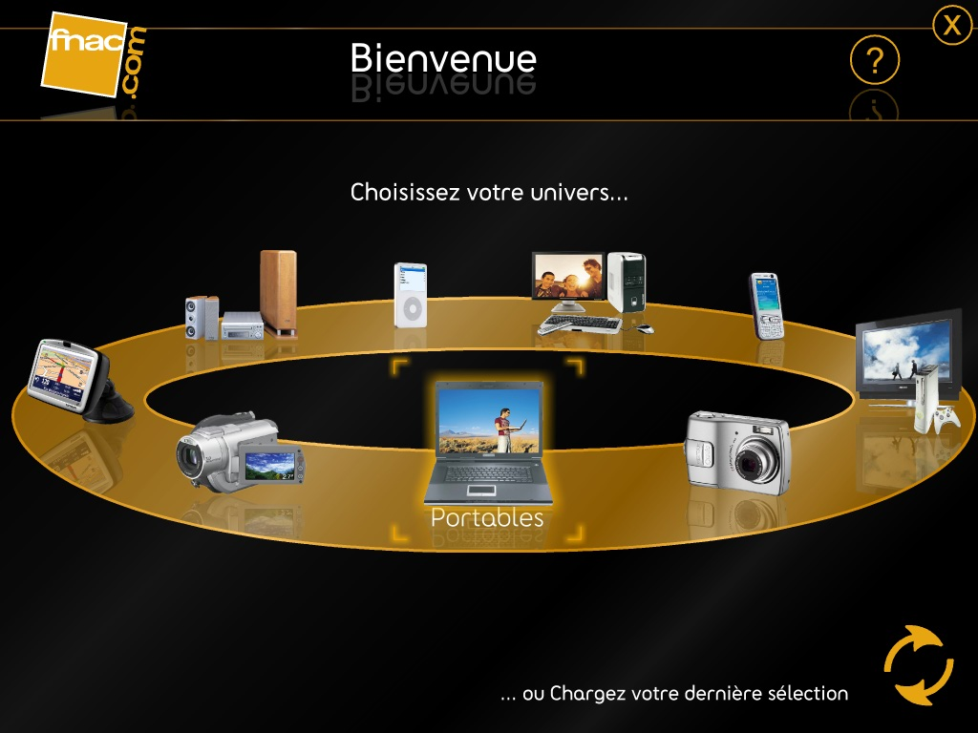
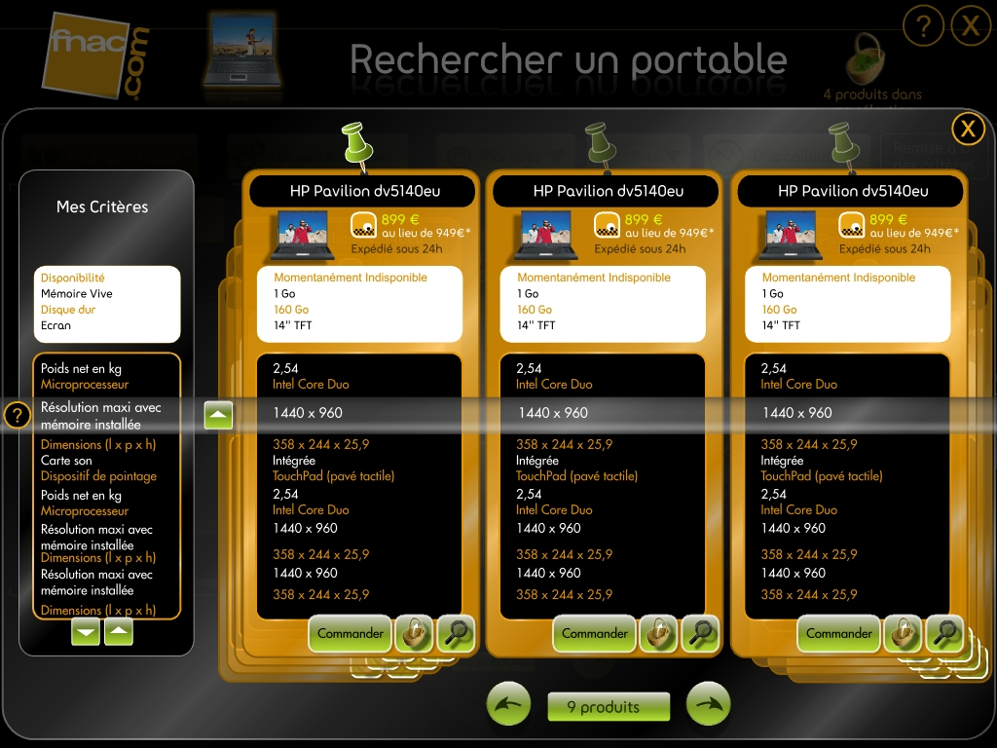
fnac.com
French Technology Retailer

Slide 10
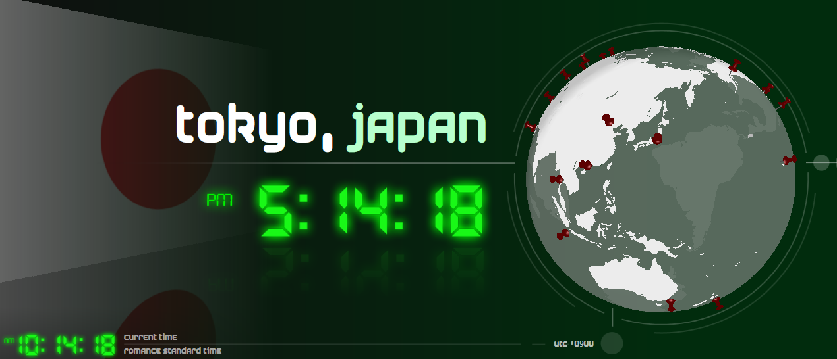
Zam3D
3D XAML Tools

Slide 11
WPF Technical Overview

Slide 12
Key Platform Concepts
WPF | Analogy
XAML | HTML
Layout | WinForms 2.0 Panels
Data Binding | ASP.NET syntax
Data Templates | ASP.NET Templates
Styles | CSS
Control Templates | User Control
3D | Managed DirectX
Animation | Flash
http://msdn.microsoft.com/msdnmag/issues/06/01/WindowsPresentationFoundation/default.aspx

Slide 13





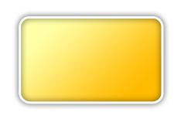















Architecture
DOCUMENT SERVICES
USER INTERFACE SERVICES
XPS Documents
Application Services
Controls
Databinding
Packaging Services
Deployment Services
Layout
XPS Viewer
MEDIA INTEGRATION LAYER
BASE SERVICES
Windows Presentation Foundation
Imaging
2D
Audio
XAML
Text
Effects
3D
Video
Accessibility
Animation
Input & Eventing
Composition Engine
Property System
Unmanaged
Property Engine
Input / Eventing System
Managed
Desktop Windows Manager
Composition Engine
Media Integration Layer
Windows Media Foundation
.NET Framework 2.0
DirectX
Windows Vista Display Driver (LDDM)
Print Spooler

Slide 14
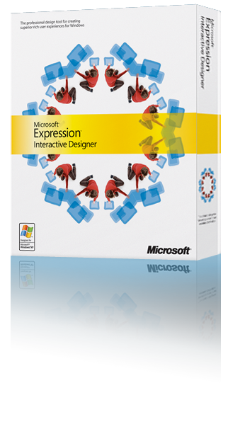


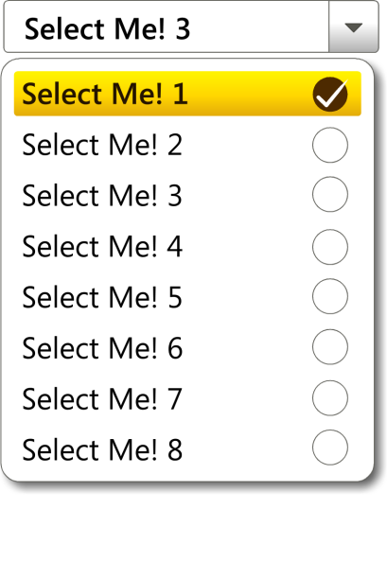
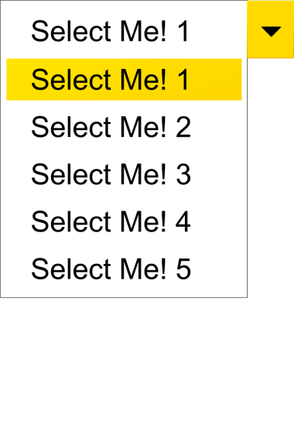
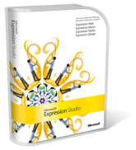



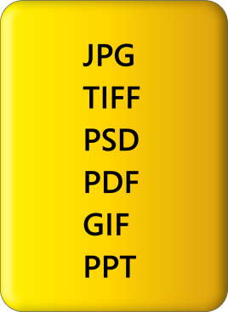
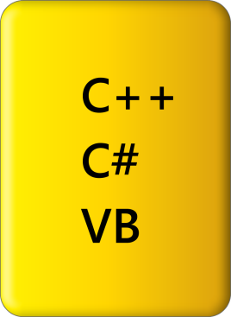


Designer - Développeur
Microsoft Tools for Designers and Developers
Declarative Programmation: XAML
Tiers Tools: Aurora - Mobiform, ZAM 3D - Electric Rain
  Designers and developers
  collaborations
Notes:
14

Slide 15
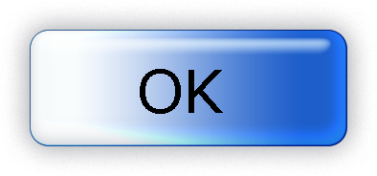




XAML: Declarative Programming for Windows
Markup for Windows
  Build applications in simple declarative statements
  Can be used for any CLR object hierarchy (not just WPF)
Code and content are separate
  Streamline collaboration between designers and developers
Easy for tools to consume and generate
<Button Width="100">OK
<Button.Background>
LightBlue
</Button.Background>
</Button>
Button b1 = new Button();
b1.Content = "OK";
b1.Background = new
SolidColorBrush(
Colors.LightBlue);
b1.Width = 100;
Dim b1 As New Button
b1.Content = "OK"
b1.Background = New _
SolidColorBrush _
(Colors.LightBlue)
b1.Width = 100

Slide 16




Controls, Templates, Styles & Resources, Layouts, Animation
Animation, Triggers, Timelines
Templated
Button
<StackPanel>
<StackPanel.Triggers>
<EventTrigger RoutedEvent="Button.Click">
<EventTrigger.Actions>
<BeginStoryboard>
<BeginStoryboard.Storyboard>
<Storyboard>
<ColorAnimation
To="Yellow"
Duration="0:0:0.5"
<DoubleAnimation
To="45"
Duration="0:0:2"
...
</StackPanel.Triggers>
</StackPanel>
UI Services
Templates
Layout
Controls Library
Styles and Resources
Annotation
Notes:
16

Slide 17
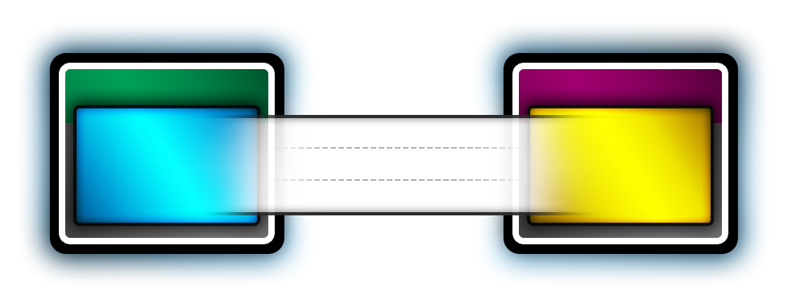
Data Binding
<StackPanel>
<Label>Select A Customer</Label>
<ListBox
Name="myListBox"
Background="HoneyDew"
ItemsSource="{Binding
{StaticResource mySource}}"
</ListBox>
</StackPanel>
Binding Target
Binding Source
Dependency Object
Object
Dependency Property
OneWay
TwoWay
Property
OneWayToSource
UI can be bound to CLR objects or XML
Dependency properties can also be bound to ADO.NET
and objects associated with Web Services and Web properties
Sort, filter, and group views can be generated on top of the data
Data templates can be applied to data
Notes:
17

Slide 18

Integrated Vector-based
Graphics and Composition
Modern graphics capabilities
  2D and 3D graphics
  Image effects and codec
  Hardware accelerated sub-pixel ClearType
  Video and audio
Revolutionizing the graphics and media pipeline
  Across the display, audio, printing, and remoting subsystems
  Direct3D-based hardware acceleration throughout the rendering pipeline
Anticipates future hardware technologies
  Resolution independence
  Double floating point precision
  Deeper color pipeline
Enabling high-quality, cinematic experiences

Slide 19


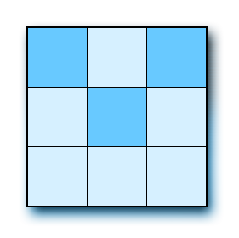


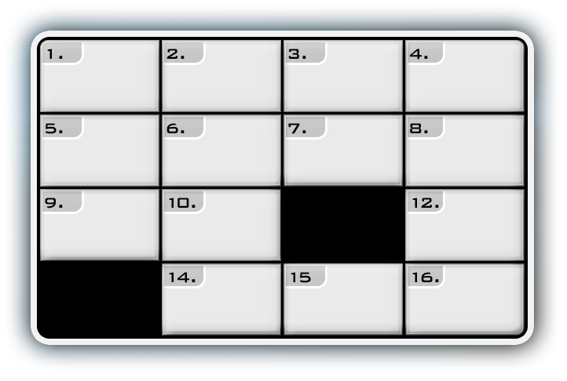

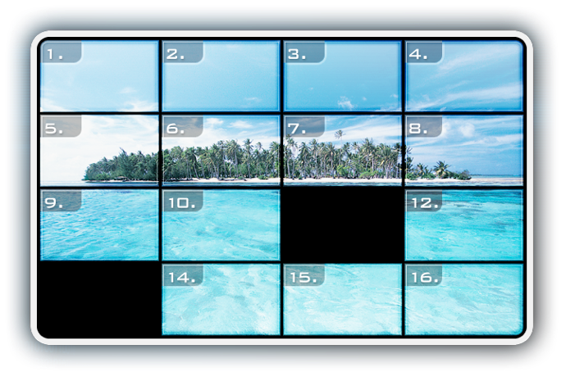
2D Graphics, 3D Graphics, Imaging
2D Graphics
Imaging
Notes:
19

Slide 20

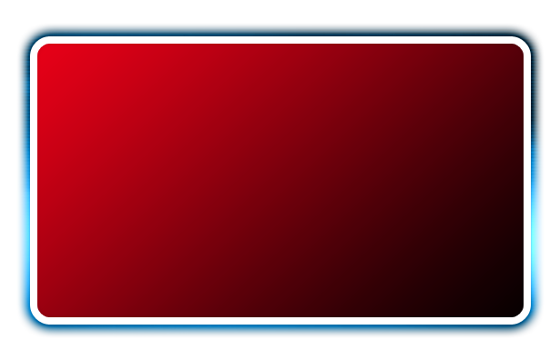
Audio & Video
<Border Width="400"
BorderBrush="Green"
BorderThickness="9">
<StackPanel>
<MediaElement Source="aero.wmv" />
<Button>Hello</Button>
</StackPanel>
</Border>
Formats: WMV, MPEG, Some AVIs
Can be synchronized with animations
Windows Media Foundation used to instantiate playback machinery into a DirectShow graph
Notes:
20

Slide 21
User Interface Elements

Slide 22
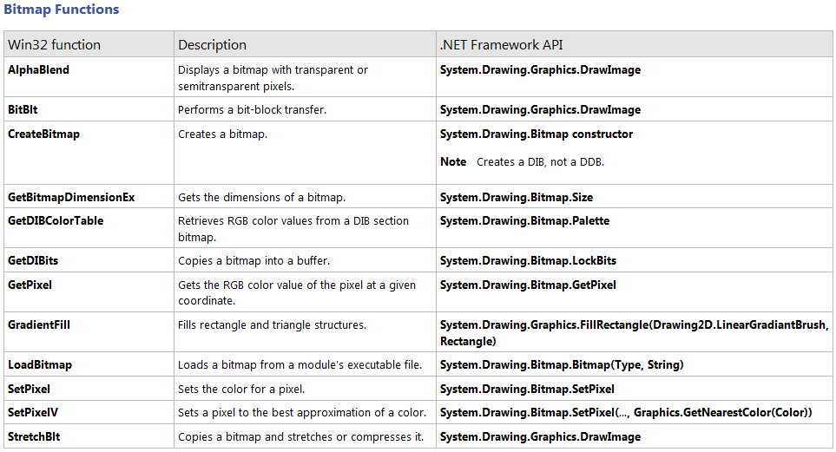
Windows Forms
Object encapsulation of Win32 GDI and controls
    Benefits of the current OS
    Limited by the constraints of interoperability
    Component Model
    Data Binding
    Collections,
    delegates,
    hierarchy of controls
http://msdn.microsoft.com/en-us/library/aa302340.aspx

Slide 23
Windows Presentation Foundation
New Windows interface model (windows, forms, drawings, images, video, 3D)
Animation engine
Document management (fixed, flow)
Design possibilities: XAML, styles, templates
Display model based on DirectX (vector, 2D, 3D)
Total abstraction of OS constraints (pure solution. NET)

Slide 24
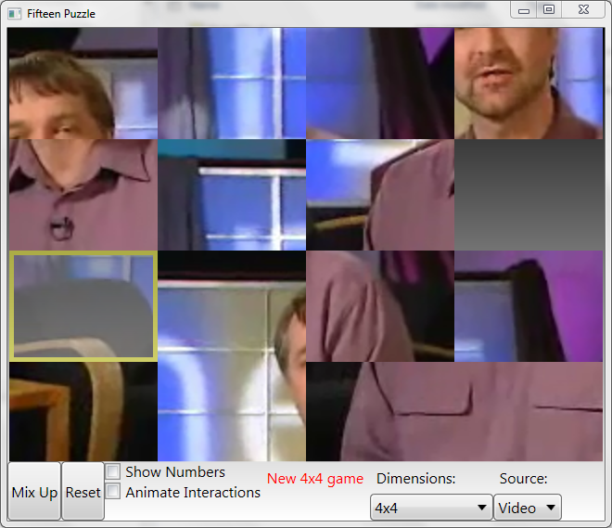
Demo
Filteen Puzzle
Microsoft Demonstration of WPF

Slide 25
Window in XAML
MainWindow.xaml
  x:Class xmlns xmlns:x
  Title Height Width
MainWindow.xaml.cs
<Window x:Class="WpfApplication1.MainWindow"
xmlns="http://schemas.microsoft.com/winfx/2006/xaml/presentation"
xmlns:x="http://schemas.microsoft.com/winfx/2006/xaml"
Title="MainWindow" Height="135" Width="404">
<Grid>
</Grid>
</Window>
namespace WpfApplication1
{
public partial class MainWindow : Window
{
public MainWindow()
{
InitializeComponent();
}
}
}

Slide 26
Components
UIElement
FrameworkElement
Control
ItemsControl
Panel
Shape
Label
Button
Calendar
CheckBox
Frame
Image
MediaElement
RadioBox
RadioButton
RichTextBox
ScrollViewer
TextBox
TextBlock
ToolTip
UserControl
Window
DataGrid
TreeView
ComboBox
ListBox
ListView
Menu
StatusBar
TabControl
Canvas
DockPanel
Grid
StackPanel
TabPanel
Ellipse
Line
Path
Rectange
Decorator
Border
ViewBox
ScrollBar
Slider
ProgressBar
http://msdn.microsoft.com/fr-fr/library/ms590941.aspx

Slide 27

Styles
Centralized properties
Like CSS in HTML
<Window>
<Window.Resources>
<Style x:Key="MyStyle">
<Setter Property="Button.Background" Value="Orange" />
<Setter Property="Button.FontStyle" Value="Italic" />
<Setter Property="Button.Padding" Value="8,4" />
<Setter Property="Button.Margin" Value="4" />
</Style>
</Window.Resources>
<StackPanel Orientation="Horizontal" VerticalAlignment="Top">
<Button Style="{StaticResource MyStyle}">Styles</Button>
<Button Style="{StaticResource MyStyle}">are</Button>
<Button Style="{StaticResource MyStyle}">cool</Button>
</StackPanel>
</Window>

Slide 28
Target Type
To apply a style to all defined componenents
<Window>
<Window.Resources>
<Style TargetType="Button">
<Setter Property="Background" Value="Orange" />
<Setter Property="FontStyle" Value="Italic" />
<Setter Property="Padding" Value="8,4" />
<Setter Property="Margin" Value="4" />
</Style>
</Window.Resources>
<StackPanel Orientation="Horizontal" VerticalAlignment="Top">
<Button>Styles</Button>
<Button>are</Button>
<Button>cool</Button>
</StackPanel>
</Window>
TargetType="Button"
TargetType="{x:Type Button}"

Slide 29

Triggers
Style definiton when an action occured
<Window.Resources>
<Style TargetType="{x:Type Button}">
<Setter Property="Background" Value="Orange" />
<Setter Property="FontStyle" Value="Italic" />
<Setter Property="Padding" Value="8,4" />
<Setter Property="Margin" Value="4" />
<Style.Triggers>
<Trigger Property="IsMouseOver" Value="True">
<Setter Property="Background" Value="Yellow" />
</Trigger>
</Style.Triggers>
</Style>
</Window.Resources>

Slide 30
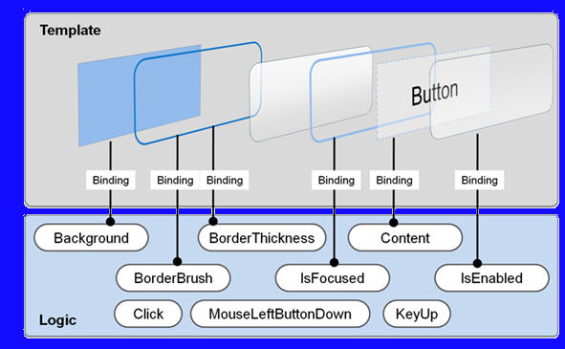
Template
Each component has a default visual model that can be redefined.

Slide 31

Template
Example
<Button Content="Styles">
<Button.Template>
<ControlTemplate TargetType="{x:Type Button}">
<Grid>
<Ellipse Fill="{TemplateBinding Background}"
Stroke="{TemplateBinding BorderBrush}"/>
<ContentPresenter HorizontalAlignment="Center"
VerticalAlignment="Center"/>
</Grid>
</ControlTemplate>
</Button.Template>
</Button>

Slide 32
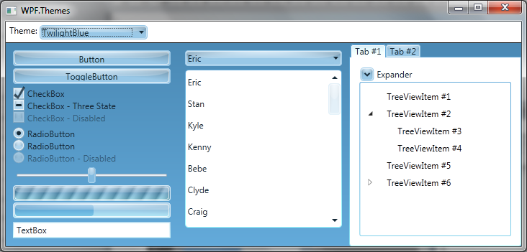
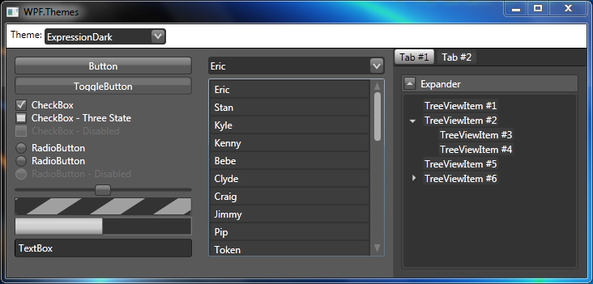
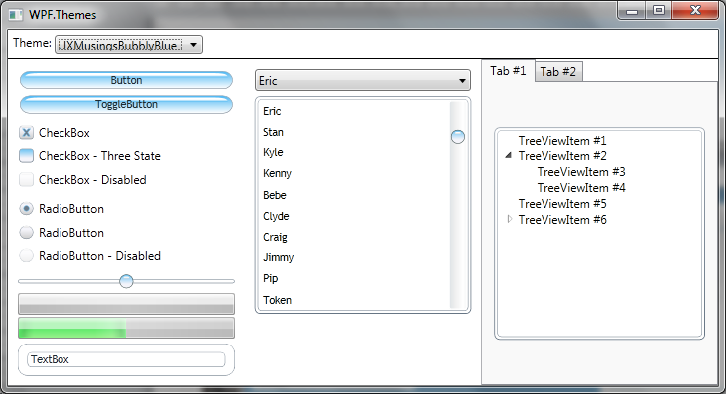
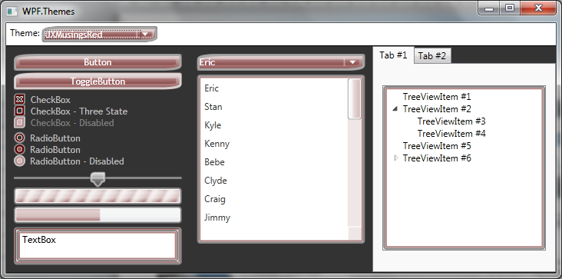
Template
http://wpfthemes.codeplex.com

Slide 33
Components
UIElement
FrameworkElement
Control
ItemsControl
Panel
Shape
Label
Button
Calendar
CheckBox
Frame
Image
MediaElement
RadioBox
RadioButton
RichTextBox
ScrollViewer
TextBox
TextBlock
ToolTip
UserControl
Window
DataGrid
TreeView
ComboBox
ListBox
ListView
Menu
StatusBar
TabControl
Canvas
DockPanel
Grid
StackPanel
TabPanel
Ellipse
Line
Path
Rectange
Decorator
Border
ViewBox
ScrollBar
Slider
ProgressBar
http://msdn.microsoft.com/fr-fr/library/ms590941.aspx

Slide 34
ListBox
Items … Collection d'éléments
Items.Count … Retourne le nombre d’éléments
SelectedItem … Élément sélectionné
SelectionMode … Mode de sélection
- Extended
- Multiple
- Single (default)
<ListBox Name="lstCity">
<ListBoxItem>New York</ListBoxItem>
<ListBoxItem IsSelected="True">Los Angeles</ListBoxItem>
<ListBoxItem>Paris</ListBoxItem>
<ListBoxItem>Zürich</ListBoxItem>
</ListBox>

Slide 35
Menu
Menu accessible via la touche ALT ou F10
  Header
  MenuItem.Icon
  Separator
  IsChekable
  IsChecked
  Click
<Menu>
<MenuItem Header="_File">
<MenuItem Header="_Open"
IsEnabled="True"
Click="mnuFileOpen_Click">
<MenuItem.Icon>
<Image Source="Images/edit.gif" />
</MenuItem.Icon>
</MenuItem>
<Separator />
<MenuItem Header="_Print" IsCheckable="True"
IsChecked="True" />
</MenuItem>
</Menu>

Slide 36
Events
Routed Events
  Event handlers can call on multiple listeners in a tree of elements.
Routing strategy *
  Bubble: Event propagation Up
  Direct : Like Windows Forms
  Tunnel : Event propagation bottom (by convention,
  prefixed with Preview).
  * Defined by the initial developer

Slide 37
Events
Example
<Grid Button.Click="Grid_Click">
<StackPanel>
<StackPanel Orientation="Horizontal">
<Button Name="btnYes" Content="Yes" Click="btnYes_Click"/>
<Button Name="btnNo" Content="No" />
</StackPanel>
<ListBox Name="ListBox1" Height="100" />
</StackPanel>
</Grid>
private void btnYes_Click(object sender, RoutedEventArgs e)
{
ListBox1.Items.Add("btnYes_Click");
}
private void Grid_Click(object sender, RoutedEventArgs e)
{
ListBox1.Items.Add("Grid_Click");
}
e.Handled = true;

Slide 38
Binding

Slide 39
Binding to simple element
<Label Name="lblLastname" Content="Lastname:" />
<TextBox Name="txtLastname" Text="{Binding Path=LastName}" />
List<Employee> employees = new List<Employee>();
employees.Add(new Employee() { LastName = "Voituron", FirstName = "Denis" });
employees.Add(new Employee() { LastName = "Dubois", FirstName = "Anne“ });
this.DataContext = employees;
Display the first item

Slide 40
Binding to Items Control
<ListBox Name="lstEmployees" DisplayMemberPath="LastName" />
List<Employee> employees = new List<Employee>();
employees.Add(new Employee()
{
LastName = "Voituron",
FirstName = "Denis"
});
employees.Add(new Employee()
{
LastName = "Dubois",
FirstName = "Anne"
});
lstEmployees.ItemsSource = employees;

Slide 41
Data Template
Display an item of ItemSource
<ListBox Height="100" Width="300" ItemsSource="{Binding .}">
<ListBox.ItemTemplate>
<DataTemplate>
<StackPanel Orientation="Horizontal">
<TextBlock Text="{Binding Path=LastName}" Foreground="Red" />
<TextBlock Text=" " />
<TextBlock Text="{Binding Path=FirstName}" />
</StackPanel>
</DataTemplate>
</ListBox.ItemTemplate>
</ListBox>

Slide 42
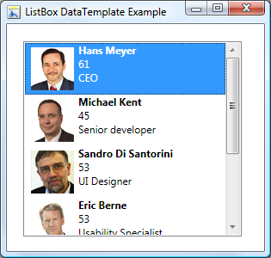
DataTemplate
<DataTemplate x:Key="EmployeeDataTemplate">
<Grid>
<Grid.ColumnDefinitions>
<ColumnDefinition Width="60"/>
<ColumnDefinition Width="*"/>
</Grid.ColumnDefinitions>
<Border Margin="5" BorderBrush="Black" BorderThickness="1">
<Image Source="{Binding Path=Image}" Stretch="Fill" Width="50" Height="50" />
</Border>
<StackPanel Grid.Column="1" Margin="5">
<StackPanel Orientation="Horizontal" TextBlock.FontWeight="Bold" >
<TextBlock Text="{Binding Path=Firstname}" />
<TextBlock Text="{Binding Path=Lastname}" Padding="3,0,0,0"/>
</StackPanel>
<TextBlock Text="{Binding Path=Age}" />
<TextBlock Text="{Binding Path=Role}" />
</StackPanel>
</Grid>
</DataTemplate>

Slide 43
Sorting and Filtering
Multiple sorts
Filtering
  Object Predicate
var view = CollectionViewSource.GetDefaultView(employees);
view.SortDescriptions.Add(new SortDescription("LastName",
ListSortDirection.Ascending));
var view = CollectionViewSource.GetDefaultView(employees);
view.Filter = (e => (e as Employee).Group == "Trasys");

Slide 44
Conclusion

