Slide 1
Introduction to Web Services
Ir Denis VOITURON
http://www.dvoituron.be
Version 3.1

Slide 2
Goals
Understand the importance of Web Services
Basic notions of Web Services
Being able to create and debug a Web Service
Using the .NET Framework
Using Visual Studio.

Slide 3
Agenda
Overview of Web Services
Technologies used
How to create a Web Services
How to use a Web Services
Conclusion

Slide 4
The business today
Companies
Sharing business processes
Working together
Quickly
With internet
Including heterogeneous system

Slide 5
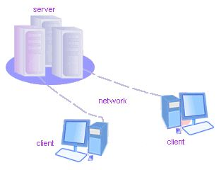
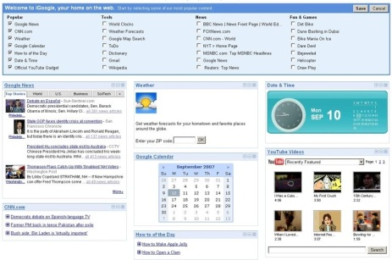
Solutions
Distributed applications
Internet Web Sites (portals)
Web Services
oData, Json

Slide 6
Distributed applications
Client / Server Model
Not extensible
Not secure
Based on distributed object model
Examples
COM, CORBA, Java RMI
Not internet based
Not interoperable
No standards

Slide 7
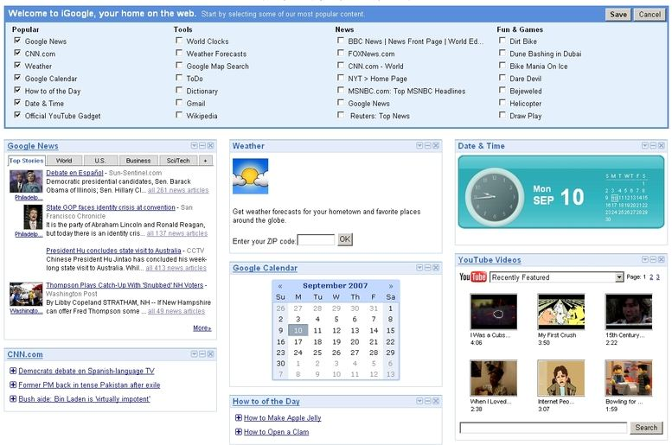
Portals
Ads
Mail
Other Svcs
Calendar
Weather
Finance
News

Slide 8
Web Services
A programmable application component that is accessible via standard Internet protocols
Web Methods HTTP
Communicate using open protocols W3C
Self-contained and self-describing XML
Usable by other applications Heterogeneous

Slide 9
Architecture
Service Broker
UDDI
WSDL
WSDL
f(x)
SOAP
Source: Wikipedia
Service Requester
Service Provider

Slide 10
Example
How to convert Number to Roman
http://www.ebob42.com/cgi-bin/Romulan.exe/wsdl/Iroman
What is the weather for a given city
http://www.deeptraining.com/webservices/weather.asmx?wsdl
Using Google, Bing, Yahoo, …

Slide 11
Agenda
Overview of Web Services
Technologies used
How to create a Web Services
How to use a Web Services
Conclusion

Slide 12
XML
XML
HTML
Technology
TCP/IP
Connectivity
Presentation
Connecting
Applications
FTP, E-mail, Gopher
Innovation
Connect the Web
Web Pages
Browse the Web
Web Services
Program the Web

Slide 13
Protocols used
UDDI
DISCO
WSDL
SOAP
XML
Internet
Publish & Find Services
Find Services on server
Formal Service Descriptions
Service Interactions
Universal Data Format
Ubiquitous Communica-tions
Simple, Open, Broad Industry Support

Slide 14
Architecture
Service Broker
UDDI
2
WSDL
WSDL
1
f(x)
3
SOAP
4
Source: Wikipedia
Service Requester
Service Provider

Slide 15
XML - eXtended Markup Language
Set of rules for encoding documents in human readable form
XML Declaration
Unicode character
Tag or Element
Attribute
<?xml version="1.0" encoding="utf-8" ?>
<note sendBy="Mail">
<to>Tove</to>
<from>Jani</from>
<heading>Reminder</heading>
<body>
Don't forget me this weekend!
</body>
</note>

Slide 16
WSDL
Web Services Description Language
Describing the functionality offered by a Web service
How the service can be called
What parameters it expects
What data structures it returns

Slide 17
WSDL
Description of GetWeather(string city)
...
<soap:element name="GetWeather">
<soap:complexType>
<soap:sequence>
<soap:element minOccurs="0" maxOccurs="1" name="City" type="soap:string"/>
</soap:sequence>
</soap:complexType>
</soap:element>
<soap:element name="GetWeatherResponse">
<soap:complexType>
<soap:sequence>
<soap:element minOccurs="0" maxOccurs="1" name="GetWeatherResult" type="soap:string"/>
</soap:sequence>
</soap:complexType>
</soap:element>
...
http://www.deeptraining.com/webservices/weather.asmx?wsdl

Slide 18
SOAP request and SOAP result
Call Web Method: GetWeather(string city)
<soap:Envelope xmlns:s="http://schemas.xmlsoap.org/soap/envelope/">
<soap:Body>
<GetWeather>
<City>Brussels</City>
</GetWeather>
</soap:Body>
</soap:Envelope>
<soap:Envelope xmlns:soap="http://schemas.xmlsoap.org/soap/envelope/"
<soap:Body>
<GetWeatherResponse>
<GetWeatherResult>Sunny</GetWeatherResult>
</GetWeatherResponse>
</soap:Body>
</soap:Envelope>

Slide 19
Security
Based on HTTP security
HTTPS
X.509 certificates
Manually crypted by developers
Firewall friendly
Type safe

Slide 20
Industrial support
Microsoft
Google
Apple
IBM
Hewlett Packard
Intel

Slide 21
Demonstration
http://www.deeptraining.com/webservices/weather.asmx?wsdl
http://localhost/math.asmx?wsdl
Demonstration

Slide 22
Agenda
Overview of Web Services
Technologies used
How to create a Web Services
How to use a Web Services
Conclusion

Slide 23
Web Services since C# 2.0
Web Services
Implemented with ASP.NET
Like Web Form page
File extension must be .asmx
Contains code but no GUI
ASP.NET can automatically generate WSDL
Can use all the classes. NET Framework

Slide 24
Web Services syntax
Code
Inline (in C#)
<%@WebService language="C#" codebehind="MyWebService.cs"
class="FirstWebService.MathService" %>
<%@WebService Language="C#" class="Service1" %>
using System.Web.Services;
[WebService()]
public class Service1 : System.Web.Services.WebService
{
[WebMethod()]
public string HelloWorld() {
return "Hello World";
}
}

Slide 25
Demo
HelloWorld.asmx
MathService.asmx
Demonstration

Slide 26
Web Services since C# 3.0
Windows Communication Framework
Similar to the web service framework 2.0, but
File extension is .svc
Based on a communication contrat
ASP.NET can automatically generate WSDL
Can use all the classes. NET Framework

Slide 27
WCF syntax
First, you must allow the web server to publish a WCF
Web.Config
<?xml version="1.0"?>
<configuration>
<system.serviceModel>
<behaviors>
<serviceBehaviors>
<behavior>
<serviceMetadata httpGetEnabled="true"/>
<serviceDebug includeExceptionDetailInFaults="true"/>
</behavior>
</serviceBehaviors>
</behaviors>
</system.serviceModel>
</configuration>

Slide 28
WCF syntax
Contract definitions
Web Service Contract
Data Contract
[ServiceContract]
interface IHelloWorldContract
{
[OperationContract]
int Add(int a, int b);
[OperationContract]
HelloMessage HelloWorld();
}
[DataContract]
public class HelloMessage
{
[DataMember]
public string Message
{
get;
set;
}
}

Slide 29
WCF syntax
Contracts implementation
HelloWorld.svc
<%@ ServiceHost Language="C#" Service = "MyWebService.HelloWorld"
CodeBehind = "HelloWorld.svc.cs" %>
HelloWorld.svc.cs
public class HelloWorld : IHelloWorldContract
{
public int Add(int a, int b)
{
return a + b;
}
HelloMessage HelloWorld()
{
return new HelloMessage() { Message = "Hello World!" };
}
}

Slide 30
Agenda
Overview of Web Services
Technologies used
How to create a Web Services
How to use a Web Services
Conclusion

Slide 31
Global overview
Find the web service
UDDI
DISCO
Find all web method signatures
WSDL
Create a Proxy to allow execute remote methods
The proxy is a local object with same methods, arguments and return values than the Web Services

Slide 32
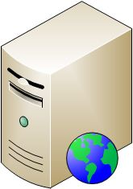
Create a Proxy
wsdl.exe
http://myserver/math.asmx?wsdl
Create Local Proxy Class
Web Service
math.asmx
wsdl
Math.cs
Execute Add Method
Program.cs
Result

Slide 33
Create a Proxy
Using Wsdl.exe to generate a Proxy 2.0
Generation of MathService.cs
Contains a class derived from SoapHttpClientProtocol
Proxy place the URL of the Web Services in the constructor
Using SvcUtil.exe to generate a Proxy 3.0
Generation of HelloWorldContractClient.cs
Contains a class derived from ServiceModel.ClientBase
Proxy place the URL of the Web Services in App.config
wsdl http://localhost/MathService.asmx?WSDL
SvcUtil http://localhost/HelloWorld.svc?WSDL

Slide 34
Create a Proxy with Visual Studio
Use Add Web Reference to a WSDL search or to find a URL via Web Services
This builds a proxy, and you can immediately start the Web Services
Visual Studio.NET calls wsdl.exe for you

Slide 35
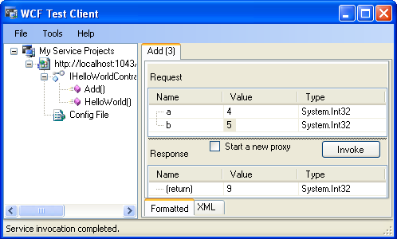
Web Methods Testing
ASMX
A ASMX web service is checkable directly in Internet Explorer.
SVC
A SVC web service is checkable via "WCF Test Client"
http://msdn.microsoft.com/en-us/library/bb552364.aspx

Slide 36
Demos
Trasys Exchange Web Services
https://webmail.trasys.be/ews/services.wsdl
Display all unread mails
Démonstration

Slide 37
Conclusion
Technologies Overview
How to create a web service
How to consume a web service
Demonstrations
Service Broker
UDDI
WSDL
WSDL
f(x)
SOAP
Service Requester
Service Provider

Slide 38
Ressources
SOAP Specification http://www.w3.org/TR/SOAP/
WSDL Specification http://www.w3.org/TR/wsdl
A Quick Introduction to WSDL http://msdn.microsoft.com/en-us/library/ms996539.aspx
UDDI http://www.uddi.org - http://uddi.microsoft.com
Microsoft .NET http://www.microsoft.com/net

